Slide 1
Session 8 Project 1
EDA: Alex Salamah

Slide 2
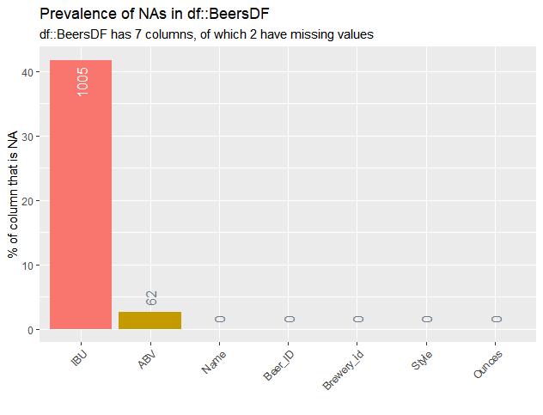
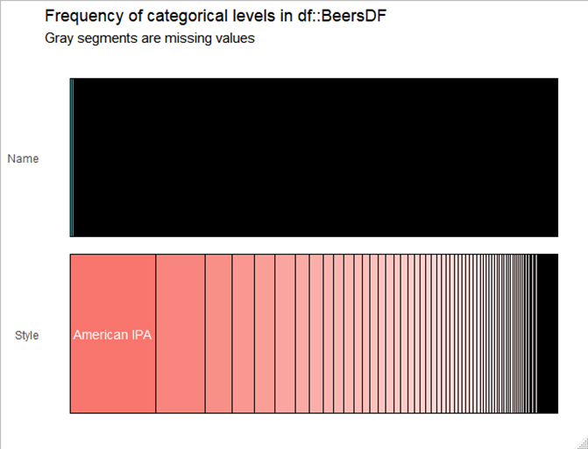
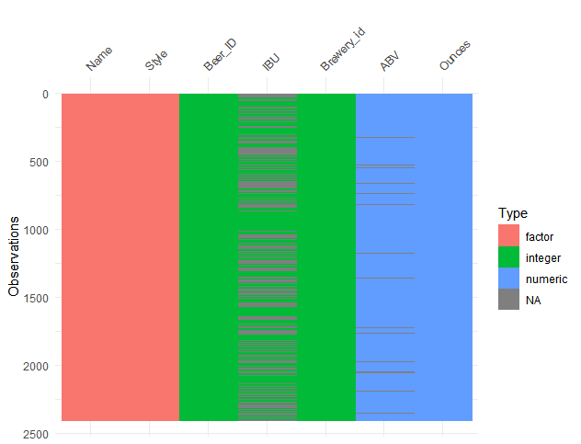
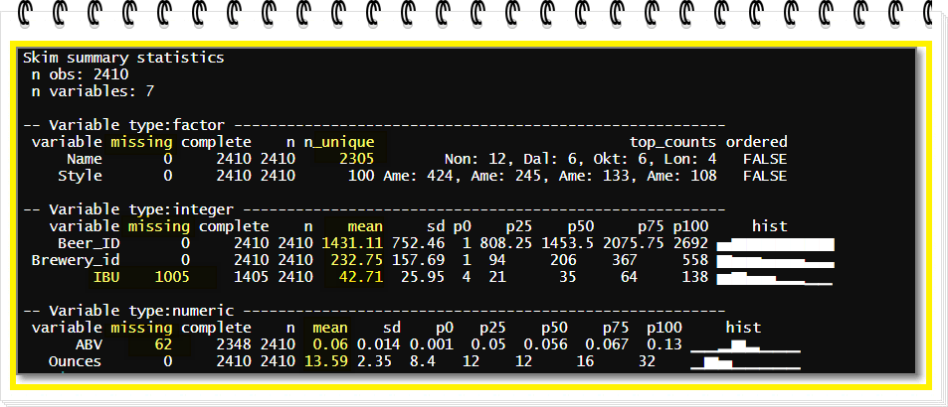
Initial Data profiling Beer Data set
The raw Beers data set consists of 2410 observations and seven variables:
Two factors: Name & Stype
Three integers: Beer ID, IBU & Brewery ID
Two numeric: ABV & Ounces
Missing Values:
A large percentage of the IBU column have missing values (45% or 1005 observations) and 62 ABV observations are also missing. I will replace missing values with mean values.
Unique Values: Beer Name has 2305 unique values and 105 duplicates. There are 100 unique Beer Styles

Slide 3
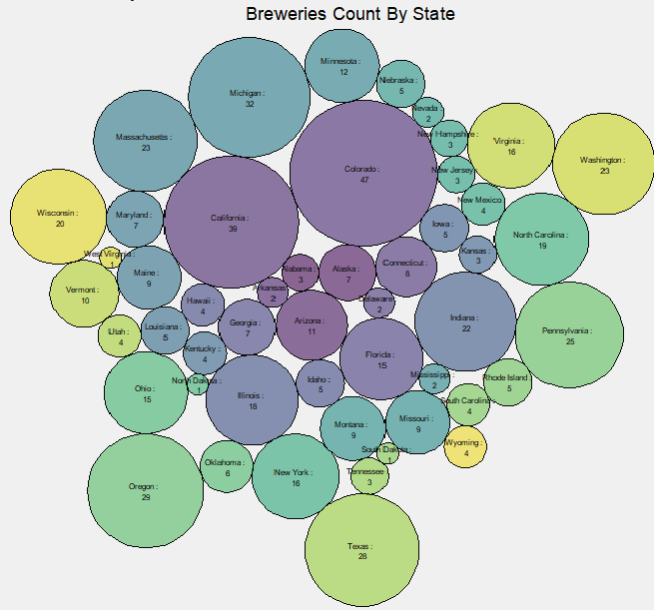
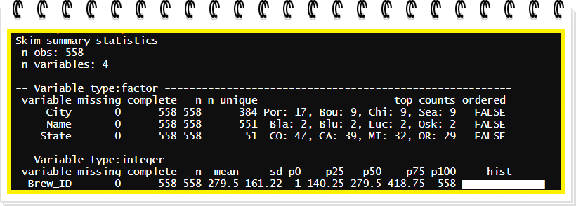
Initial Data profiling Breweries Data set
The raw Breweries data set consists of 558 observations and four variables:
Three Factors: Name, City & State
One Integer: Brewery ID, IBU & Brewery ID
Two numeric: ABV & Ounces
Missing Values: None
Unique Values: The Breweries are spread out across 384 cities in 51 states

Slide 4
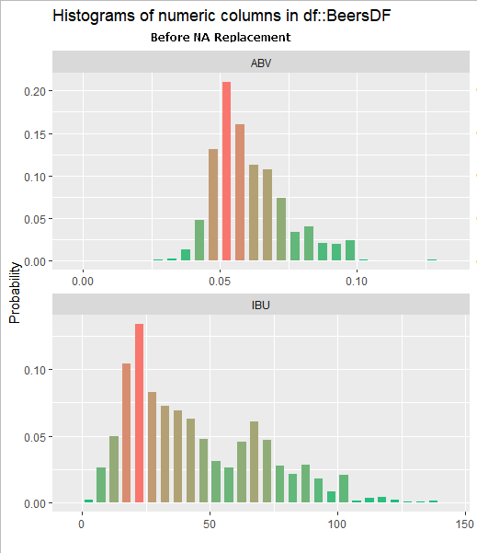
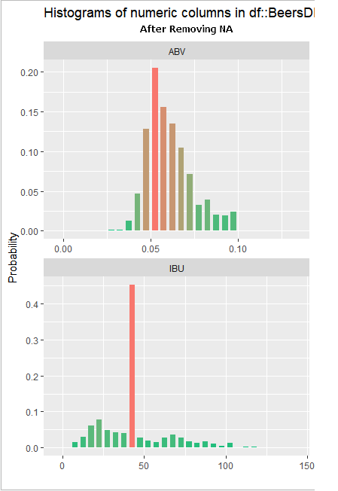
Data Cleansing Beer Data set
The raw Beers data set consists of 2410 observations and seven variables:
Two factors: Name & Stype
Three integers: Beer ID, IBU & Brewery ID
Two numeric: ABV & Ounces
Missing Values:
A large percentage of the IBU column have missing values (45% or 1005 observations) and 62 ABV observations are also missing. I will replace missing values with mean values.
Unique Values: Beer Name has 2305 unique values and 105 duplicates. There are 100 unique Beer Styles

Slide 5
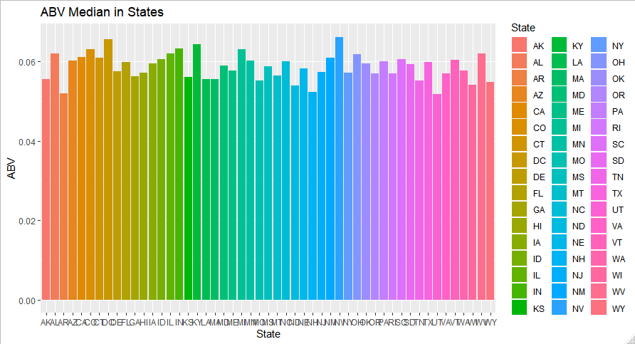
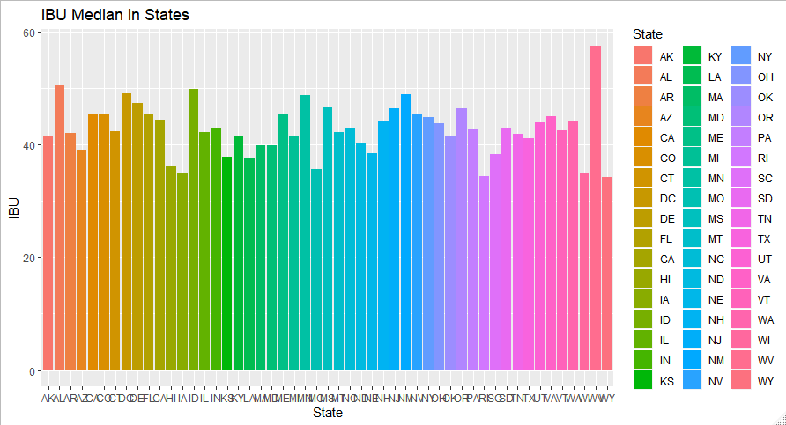
Initial Data profiling Breweries Data set

Slide 6
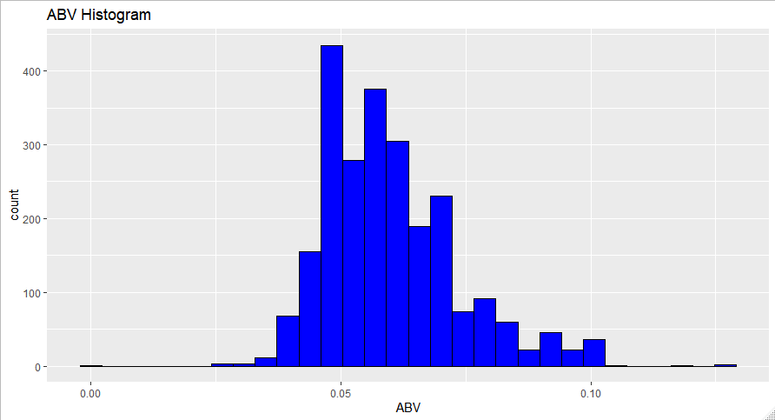
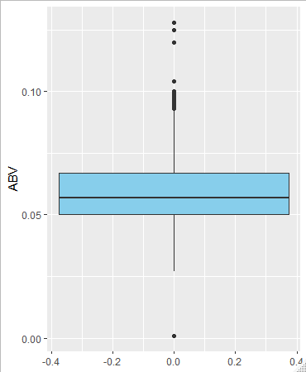
Initial Data profiling Breweries Data set

